Slide 1
dast
ow

Slide 2
dast
Dynamic Application Security Testing (DAST) is the process of analyzing a web application through the front-end to find vulnerabilities through simulated attacks.
This type of approach evaluates the application from the “outside in” by attacking an application like a malicious user would.
After a DAST scanner performs these attacks, it looks for results that are not part of the expected result set and identifies security vulnerabilities.

Slide 3
..
Dynamic Application Security Testing (DAST) involves evaluating the security of an application while it is running by simulating real-world attack scenarios. DAST mimics the behavior of a malicious external attacker, testing the application’s responses to various inputs and interactions.
However, unlike actual attacks, the primary goal of DAST is not to break into the system or cause disruption, but rather to identify vulnerabilities that could be exploited.
These tests are performed from an external perspective, focusing on how the application behaves in a live environment, detecting issues such as input validation flaws, security misconfigurations, and other runtime vulnerabilities.

Slide 4
Why dast
DAST is important because developers don’t have to rely solely on their own knowledge when building applications. By conducting DAST during the SDLC, you can catch vulnerabilities in an application before it’s deployed to the public. If these vulnerabilities are left unchecked and the app is deployed as such, this could lead to a data breach, resulting in major financial loss and damage to your brand reputation. Human error will inevitably play a part at some point in the Software Development Life Cycle (SDLC), and the sooner a vulnerability is caught during the SDLC, the cheaper it is to fix.
When DAST is included as part of the Continuous Integration/Continuous Development (CI/CD) pipeline, this is referred to as “Secure DevOps,” or “DevSecOps.”

Slide 5
How does DAST work?
A DAST scanner searches for vulnerabilities in a running application and then sends automated alerts if it finds flaws that allow for attacks like SQL injections, Cross-Site Scripting (XSS), and more. Since DAST tools are equipped to function in a dynamic environment, they can detect runtime flaws which SAST tools can’t identify.
To use the example of a building, a DAST scanner can be thought of like a security guard. However, rather than just making sure the doors and windows are locked, this guard goes a step further by attempting to physically break into the building.
The guard might try to pick the locks on the doors or break windows. After finishing this examination, the guard could report back to the building manager and provide an explanation of how he was able to break into the building. A DAST scanner can be thought of in this same way – it actively attempts to find vulnerabilities in a running environment so the DevOps team knows where and how to fix them.

Slide 6
..
dentification of vulnerable inputs: Attackers first identify inputs within the web application that are vulnerable to SQL injection. These inputs could be text fields in a form, URL parameters, or any other input mechanisms.
Crafting the malicious SQL query: Once a vulnerable input is identified, attackers craft a SQL statement intended to be inserted into the query executed by the application. This statement is designed to modify the original SQL query to perform actions unintended by the application developers.
Bypassing application security measures: Attackers often have to bypass security measures like input validation or escaping special characters. They achieve this through techniques like string concatenation or utilizing SQL syntax to comment out parts of the original query.
Executing the malicious query: When the application executes the SQL query, it includes the attacker’s malicious input. This modified query can perform actions such as unauthorized viewing of data, deletion of data, or even database schema alterations.

Slide 7
..
Tesla vulnerability—in 2014, security researchers publicized that they were able to breach the website of Tesla using SQL injection, gain administrative privileges and steal user data.
Cisco vulnerability—in 2018, a SQL injection vulnerability was found in Cisco Prime License Manager. The vulnerability allowed attackers to gain shell access to systems on which the license manager was deployed. Cisco has patched the vulnerability.
Fortnite vulnerability—Fortnite is an online game with over 350 million users. In 2019, a SQL injection vulnerability was discovered which could let attackers access user accounts. The vulnerability was patched

Slide 8
example
Consider a simple authentication system using a database table with usernames and passwords. A user’s POST request will provide the variables user and pass, and these are inserted into a SQL statement:
sql = "SELECT id FROM users WHERE username='" + user + "' AND password='" + pass + "'"
The problem here is that the SQL statement uses concatenation to combine data. The attacker can provide a string like this instead of the pass variable:
password' OR 5=5
The resulting SQL query will be run against the database:
SELECT id FROM users WHERE username='user' AND password='pass' OR 5=5'
Because 5=5 is a condition that always evaluates to true, the entire WHERE statement will be true, regardless of the username or password provided.
The WHERE statement will return the first ID from the users table, which is commonly the administrator. This means the attacker can access the application without authentication, and also has administrator privileges.

Slide 9
Cross-Site Scripting (XSS)
Cross-Site Scripting (XSS) attacks are a type of injection, in which malicious scripts are injected into otherwise benign and trusted websites. XSS attacks occur when an attacker uses a web application to send malicious code, generally in the form of a browser side script, to a different end user.
Cross-Site Scripting (XSS) attacks occur when:
Data enters a Web application through an untrusted source, most frequently a web request.
The data is included in dynamic content that is sent to a web user without being validated for malicious content.

Slide 10
example
The following JSP code segment reads an employee ID, eid, from an HTTP request and displays it to the user.
<% String eid = request.getParameter("eid"); %>
Employee ID: <%= eid %>
The code in this example operates correctly if eid contains only standard alphanumeric text. If eid has a value that includes meta-characters or source code, then the code will be executed by the web browser as it displays the HTTP response.

Slide 11
What is a DAST tool that is well-suited for developers?
Typically, DAST is done after production since it is emulating attacks on a running application; but by making the decision to “Shift DAST left” (moving DAST earlier in the process of development) you’re able to detect vulnerabilities sooner, which saves time and money. Fortify WebInspect includes pre-built scan policies, balancing the need for speed with your organizational requirements.
Fortify WebInspect also includes an incremental scanning feature, which allows you to rapidly asses vulnerabilities in only the areas of the application that have changed.

Slide 12
SAST and DAST?
DAST attacks the application from the “outside in” by attacking an application like a malicious user would. After a DAST scanner performs these attacks, it looks for results that are not part of the expected result set and identifies security vulnerabilities.
SAST, on the other hand, analyzes static environments, meaning the source code of an application. It looks at the application from the “inside out,” searching for vulnerabilities in the code.
To maximize the strength of your security posture, it’s a best practice to use both SAST and DAST. Having this unified taxonomy across testing methods enables you to have a complete view of vulnerabilities.

Slide 13
Which DAST Tool to Use?
OWASP ZAP: User-friendly, great for beginners, lots of community support.
Burp Suite: Advanced, used by penetration testers, uncovers subtle issues.
Nikto: Comprehensive, not user-friendly, runs various tests on web servers.
Nmap: Mostly for network scanning, can spot vulnerabilities in apps.

Slide 14
ZAP
Zed Attack Proxy (ZAP) is a free, open-source penetration testing tool. It is the world’s most widely used web app scanner. It is designed specifically for testing web applications.
There are two types of ZAP scans that we use:
Baseline
Full Scan.

Slide 15
Baseline scan
Performs passive scanning only (no active attacks).
Crawls the target URL and inspects responses for security issues.
Detects vulnerabilities like missing security headers, outdated libraries, and other passive risks.
Safe for production environments as it doesn’t modify or stress test the application.

Slide 16
Full scan
Includes both passive and active scanning.
Actively attempts attacks such as SQL injection, XSS, and other common vulnerabilities.
Can potentially cause downtime or disrupt application functionality.
Suitable for testing in staging or dedicated security testing environments.

Slide 17
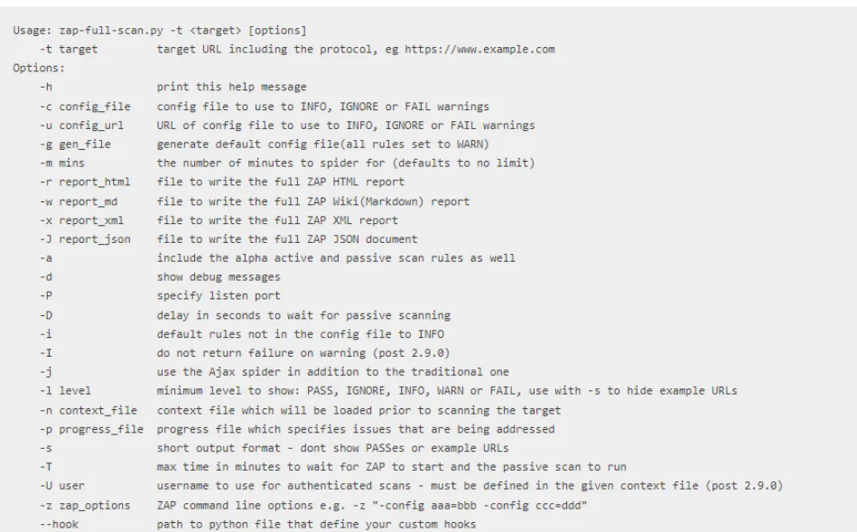
options

Slide 18
..
The IP address defined in the ZAP_TARGET variable is the IP address of the host on which the app we deployed in the test environment is running.
-r for report generation

Slide 19
Lab
Use this image
ghcr.io/zaproxy/zaproxy:latest
Run container
Create a report for website

